Slide 1
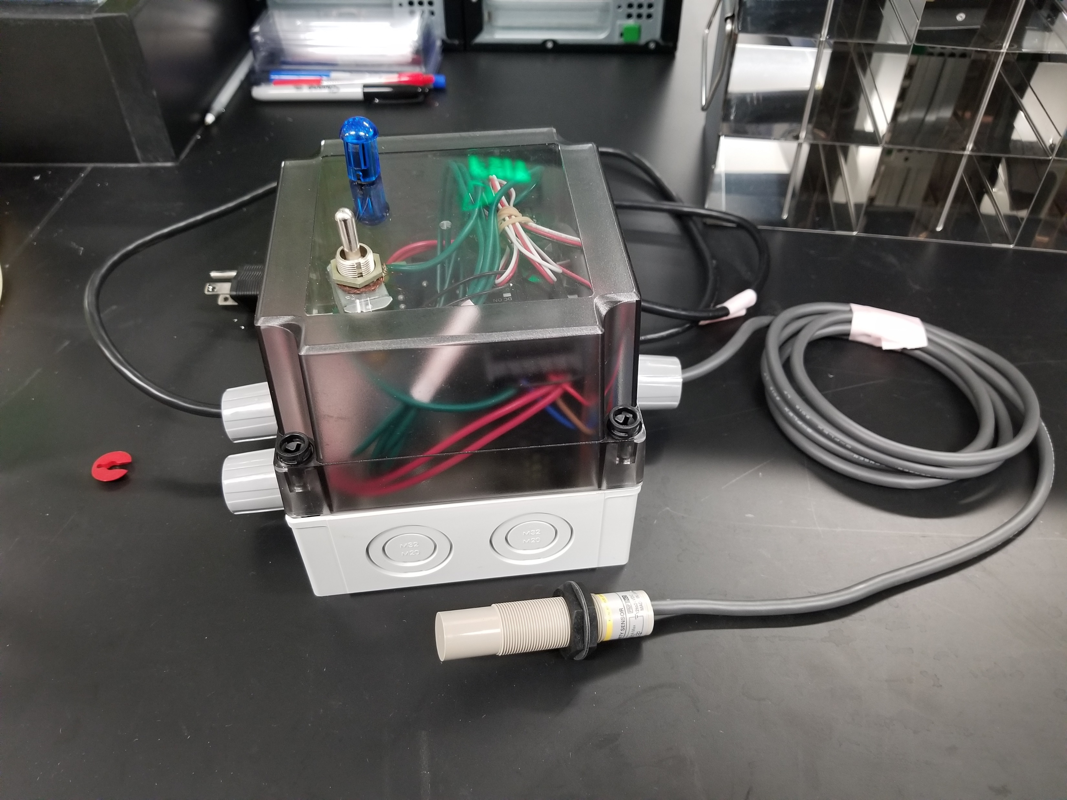
Indicator light
Toggle switch
Input / output to sensor
Input / output to outlet
Enclosure for overflow sensing system
Input / output to AC relay
Liquid sensor

Slide 2
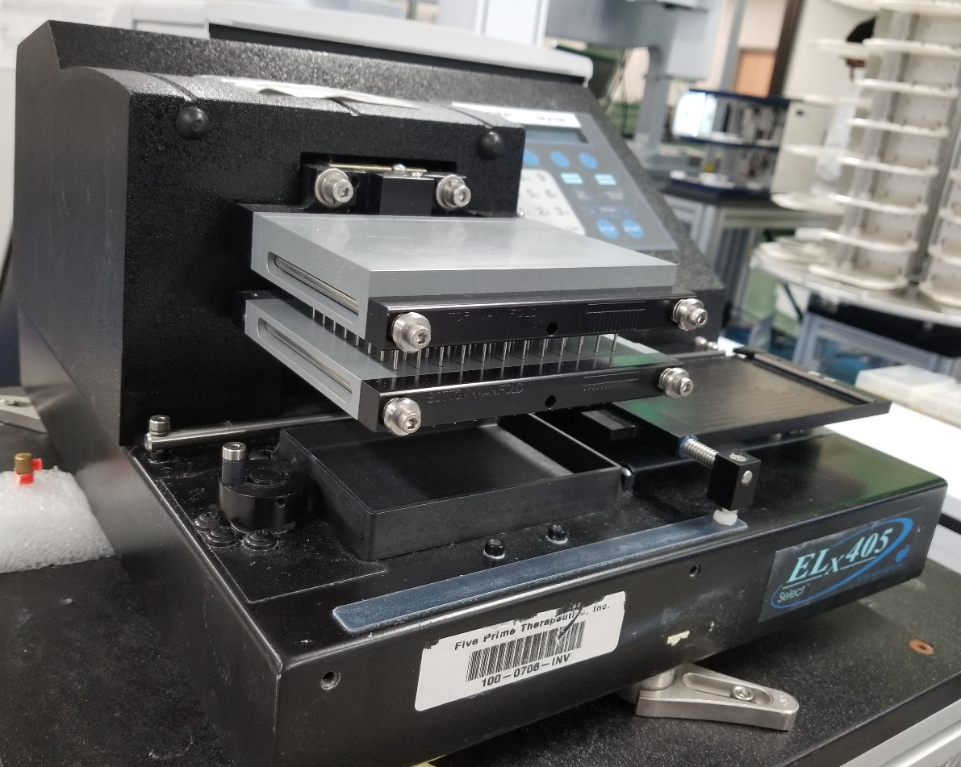

Slide 3
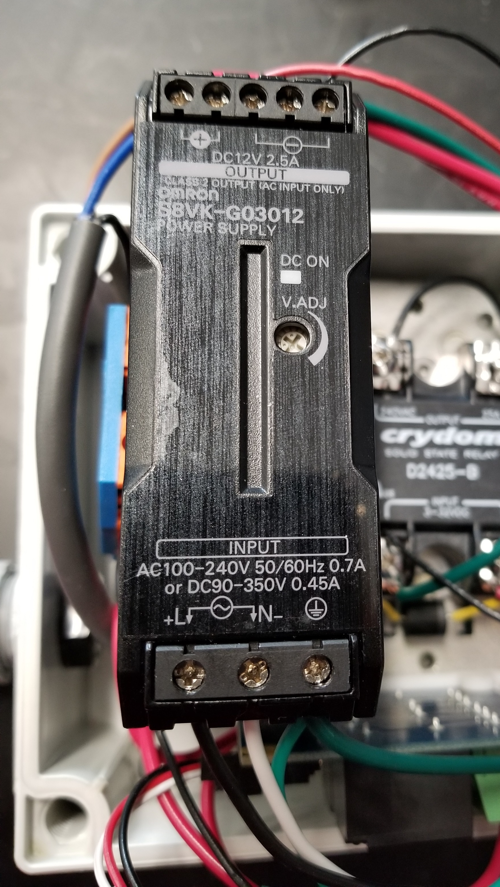
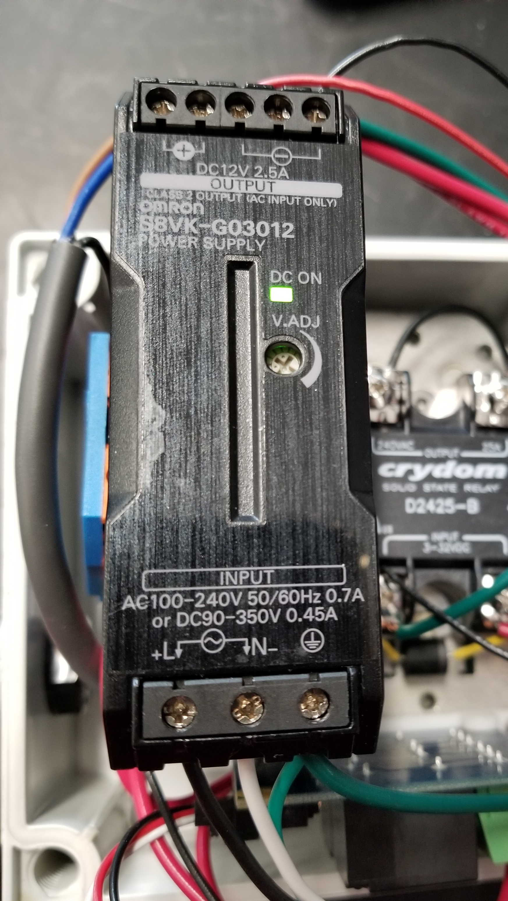

Slide 4
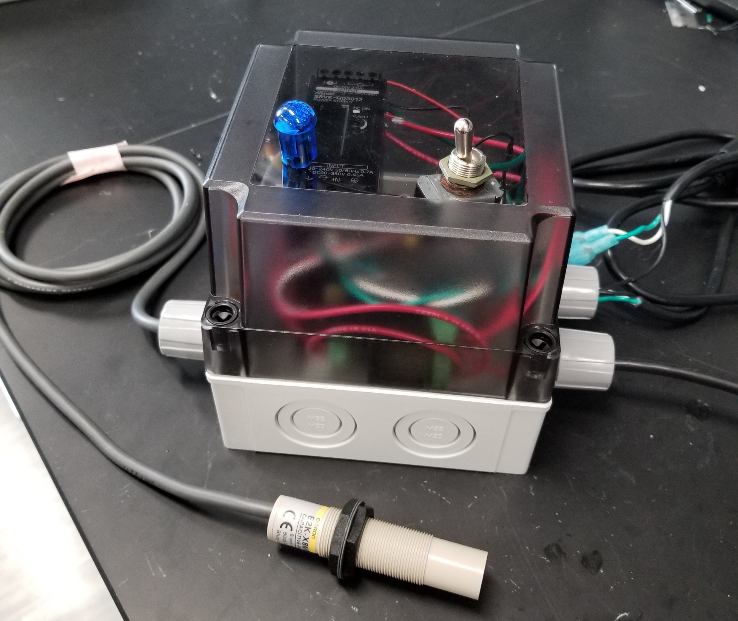
Indicator light
Toggle switch
Output of circuit to washer
Power from outlet
Input / output to sensor
Enclosure for overflow sensing system
Liquid sensor

Slide 5
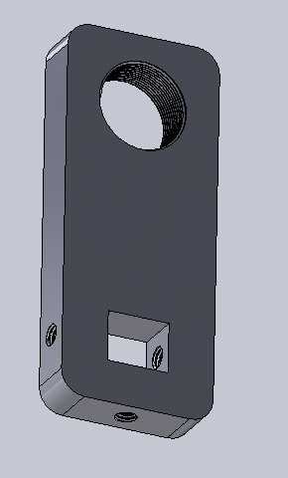
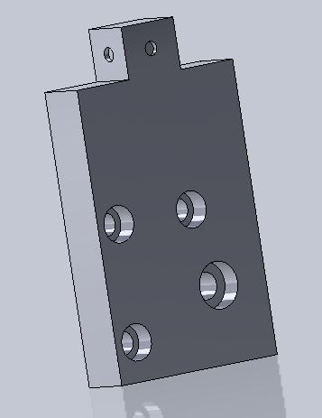
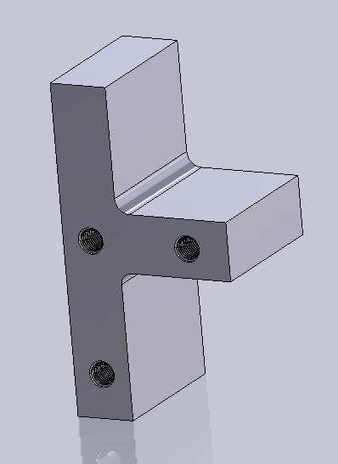
A
C
A
B
B
A
Piece 1
Piece 2
Piece 3

Slide 6
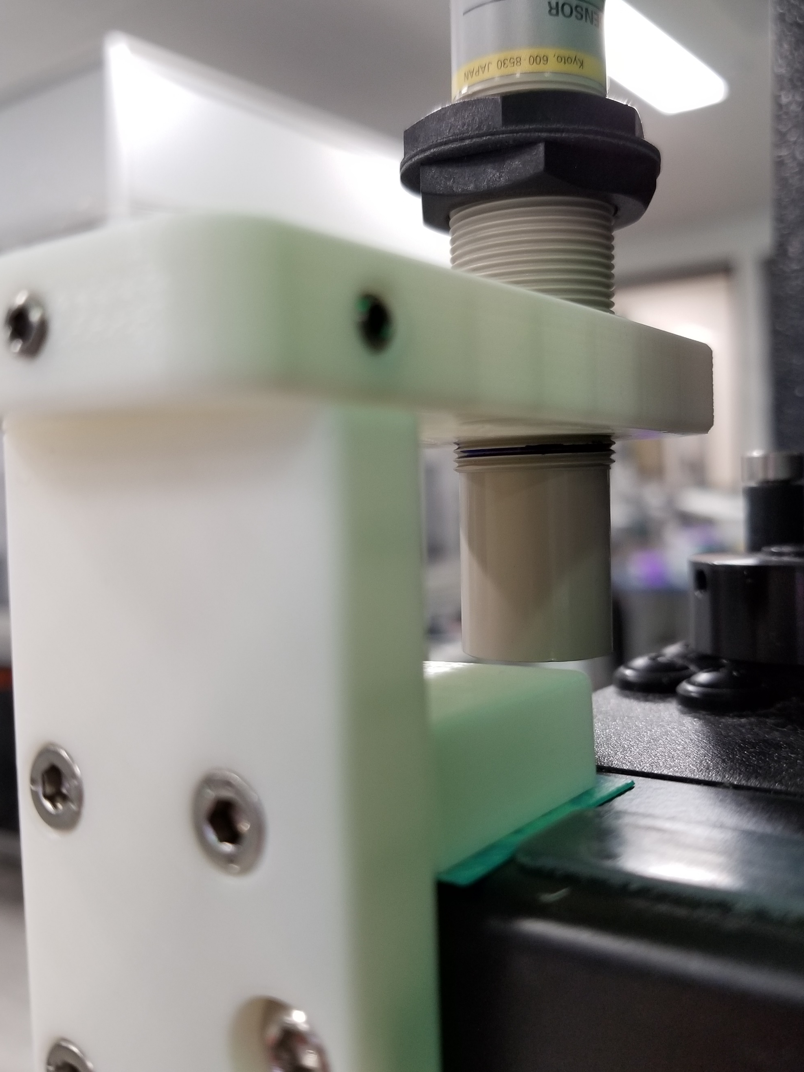

Slide 7
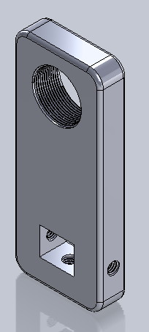
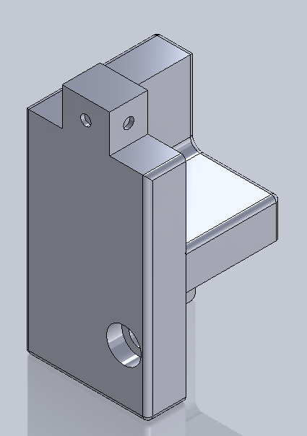
2B
1B
1A
2A
Piece 1
Piece 2

Slide 8
